Slide 1
Machine Learning
Jason Tseng
Information Engineering, KSU

Slide 2
Steps to perform machine learning in Python

Slide 3
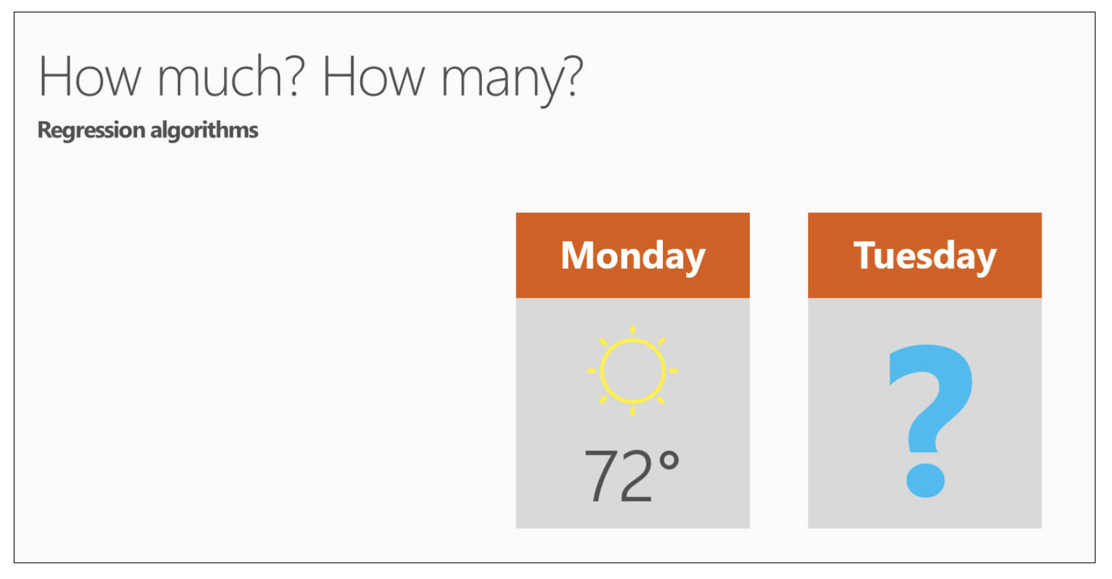
Question 3: How much? or How many? uses regression algorithms
Machine learning can also predict the answer to How much? or How many? The algorithm family that answers this question is called regression.
Regression algorithms make numerical predictions, such as:
What will the temperature be next Tuesday?
What will my fourth quarter sales be?
They help answer any question that asks for a number.

Slide 4
Classification Algorithms – Logistic Regression Algorithm
Logistic regression is a supervised learning classification algorithm used to predict the probability of a target variable.
The target or dependent variable X is binary in nature that has data coded as either X=1 (stands for success/yes) or X=0 (stands for failure/no), i.e. a logistic regression model predicting P(X=1) as a function of Y.
It is one of the simplest ML algorithms that can be used for various classification problems such as spam detection, diabetes prediction, cancer detection etc.

Slide 5
Types of Logistic Regression
Based on those number of categories, logistic regression can be divided into following types:
Binary or Binomial
a dependent variable will have only two possible types either 1 and 0. For example, these variables may represent success or failure, yes or no, win or loss etc.
Multinomial
dependent variable can have 3 or more possible unordered types or the types having no quantitative significance. For example, these variables may represent “Type A” or “Type B” or “Type C”.
Ordinal
dependent variable can have 3 or more possible ordered types or the types having a quantitative significance. For example, these variables may represent “poor” or “good”, “very good”, “Excellent” and each category can have the scores like 0,1,2,3.

Slide 6
Logistic Regression Assumptions
Before diving into the implementation of logistic regression, we must be aware of the following assumptions about the same:
In case of binary logistic regression, the target variables must be binary always, and the desired outcome is represented by the factor level 1. (The number of levels of a factor or independent variable is equal to the number of variations of that factor that were used in the experiment. E.g. An experiment compared the drug dosages 50 mg, 100 mg, and 150 mg, then the factor "drug dosage" would have three levels: 50 mg, 100 mg, and 150 mg.
There should not be any multi-collinearity in the model, which means the independent variables must be independent of each other.
We must include meaningful variables in our model.
We should choose a large sample size for logistic regression.

Slide 7
Regression Models
Binary Logistic Regression Model − The simplest form of logistic regression is binary or binomial logistic regression in which the target or dependent variable can have only 2 possible types either 1 or 0.
Multinomial Logistic Regression Model − Another useful form of logistic regression is multinomial logistic regression in which the target or dependent variable can have 3 or more possible unordered types i.e. the types having no quantitative significance.

Slide 8

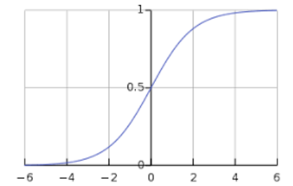

Binary Logistic Regression Model of ML
BLR model is the simplest form of logistic regression in which the target or dependent variable can have only 2 possible types either 1 or 0.
It allows us to model a relationship between multiple predictor variables and a binary/binomial target variable. In case of logistic regression, the linear function is basically used as an input to another function such as 𝑔 in the following relation −
Here, 𝑔 is the logistic (also called sigmoid) function which can be given as follows −

Slide 9
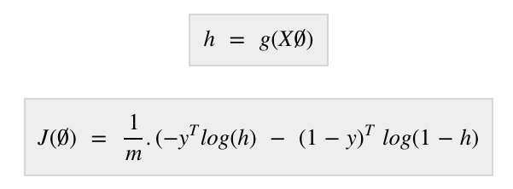
Binary Logistic Regression Model - loss function
We also need to define a loss function to measure how well the algorithm performs using the weights (theta) on functions as follows −
our prime goal is to minimize the loss function w.r.t the weight (theta).

Slide 10
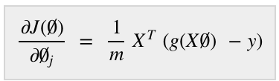
Binary Logistic Regression Model of ML
With the help of derivatives of the loss function w.r.t each weight, we would be able to know what parameters should have high weight and what should have smaller weight.
The following gradient descent equation tells us how loss would change if we modified the parameters −

Slide 11
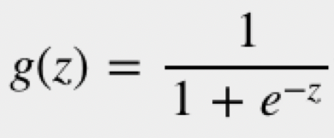
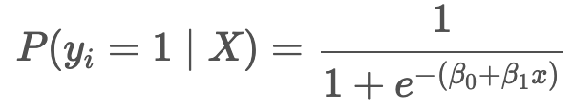
Linear model in the logistic
In a logistic regression, a linear model (e.g. β₀+β₁x) is included in a logistic g(z) function, such that
where P(y_{i}=1∣X) is the probability of the i-th observation’s target value, y_{i}, being class 1, X is the training data, β₀ and β₁ are the parameters to be learned, and e is Euler’s number.

Slide 12
Implementation in Python
Steps of implementation:
Input data: we use a multivariate flower dataset named ‘iris’ which have 3 classes of 50 instances each, but we will be using the first two feature columns. Every class represents a type of iris flower.

Slide 13
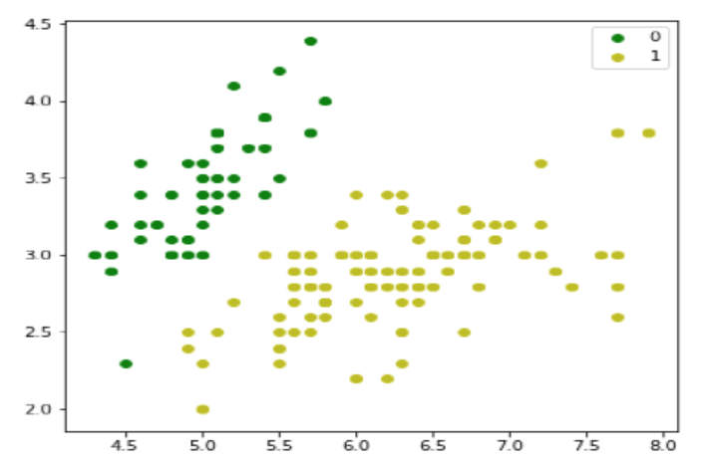
Implementation in Python
Steps of implementation:
Import the necessary libraries:
Load the iris dataset as follows −
Plot our training data as follows −

Slide 14
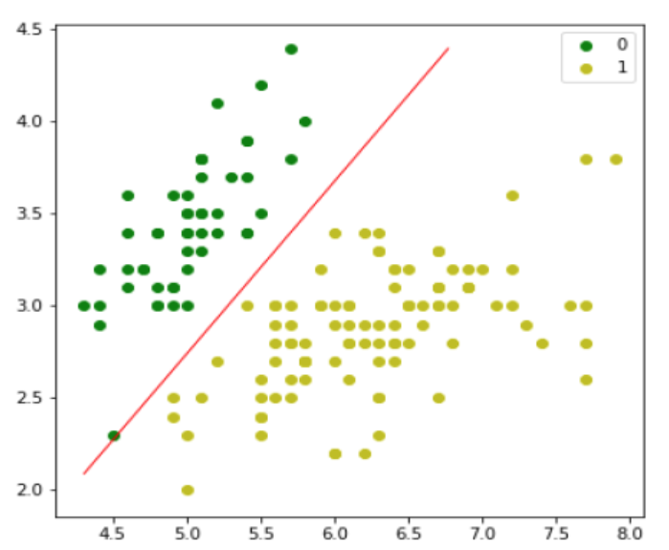
define sigmoid function, loss function and gradient descend
initialize the weights
predict the output probabilities
evaluate the model and plot it

Slide 15
Multinomial Logistic Regression Model of ML
Another useful form of logistic regression is multinomial logistic regression in which the target or dependent variable can have 3 or more possible unordered types i.e. the types having no quantitative significance.

